Slide 1
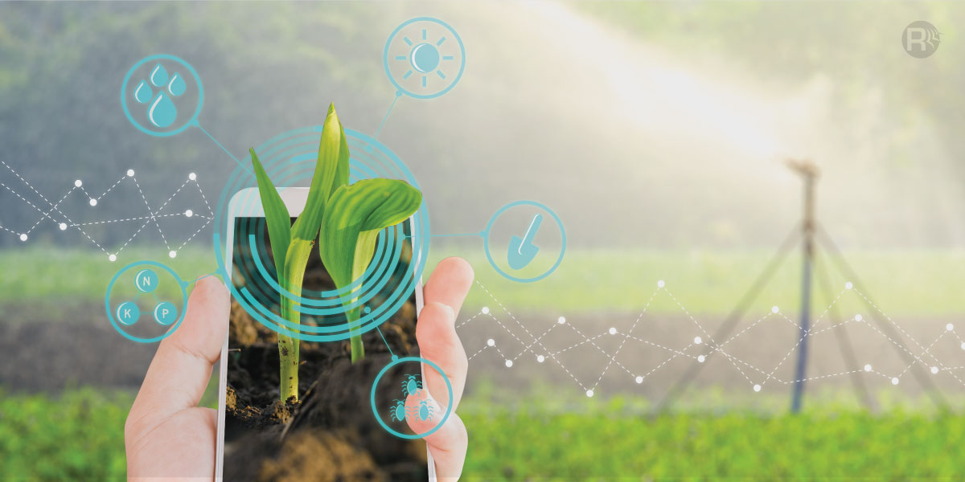
Plant Cultivation and Monitoring Solution using IOT and Machine Learning
W.Sahan Dinuka

Slide 2
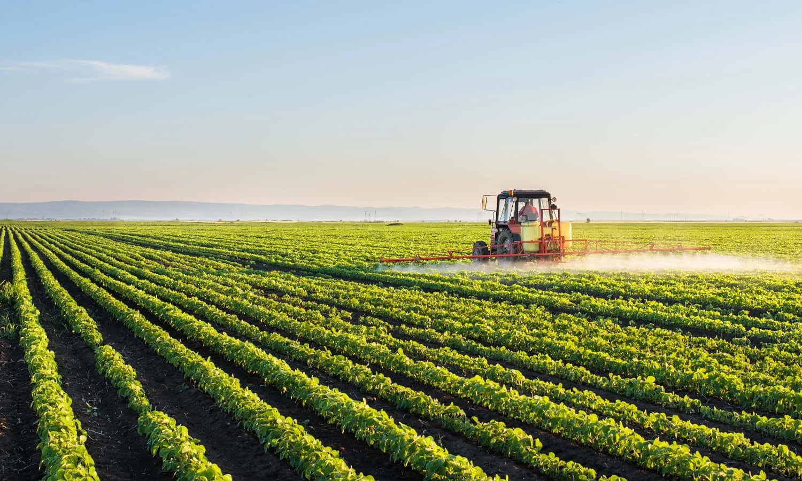
Problem statement and solution
Diverse Agricultural Factors
Farmers face challenges in navigating a complex set of variables for optimal plant growth: NPK levels, temperature, humidity, pH, and rainfall.
Traditional Decision-Making
Traditional methods for plant selection often rely on experience and are prone to suboptimal outcomes due to the dynamic nature of agricultural conditions.
Resource Inefficiencies
Suboptimal plant choices result in resource inefficiencies, leading to increased costs, reduced yields, and environmental impact.

Slide 3
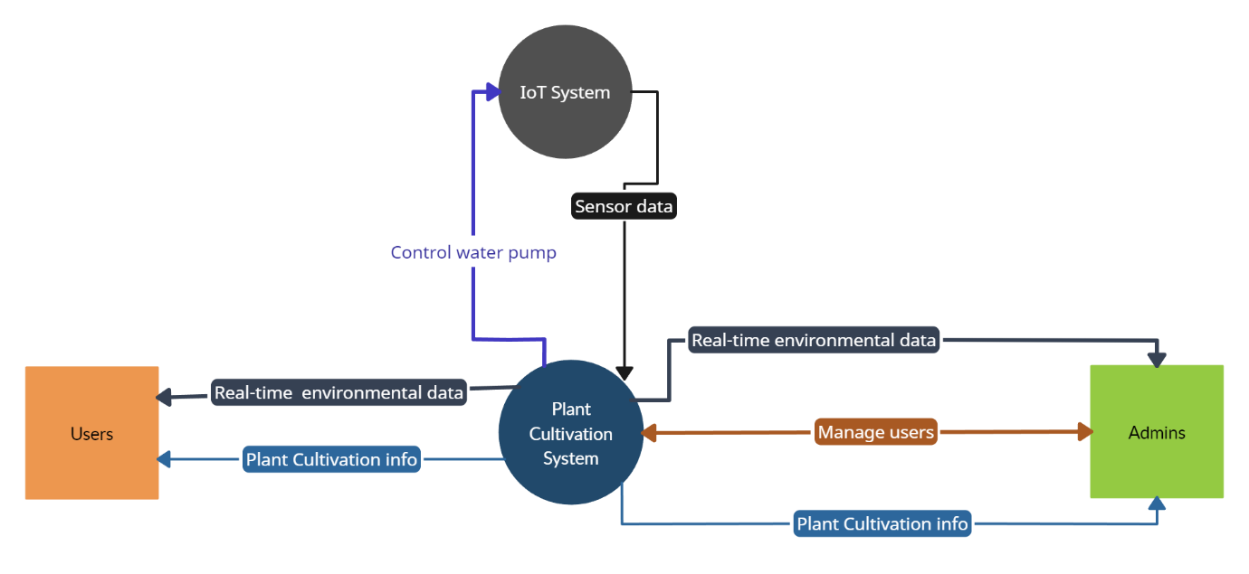
Infographic Style
Context diagram for the business

Slide 4
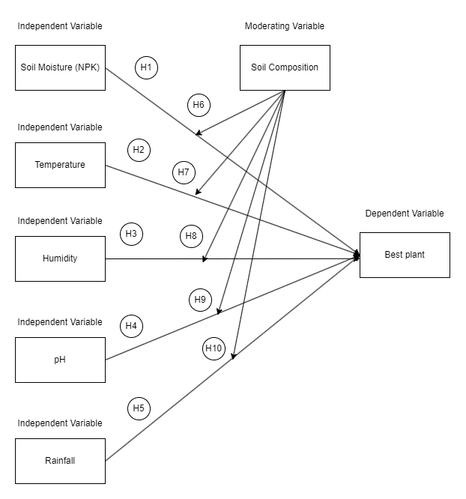
Conceptual framework and Hypothesis

Slide 5
Hypothesis
Hypothesis 1: There is a significant relationship between NPK levels and the optimal plant growth across varying soil compositions.
Hypothesis 2: Temperature variations significantly impact the choice of optimal plants to grow, moderated by soil composition.
Hypothesis 3: Humidity levels play a crucial role in determining the ideal plant species for cultivation, considering different soil compositions.
Hypothesis 4: pH levels significantly influence the selection of plants for optimal growth, contingent on soil composition.
Hypothesis 5: Rainfall patterns have a significant effect on the choice of plants best suited for growth, moderated by soil composition.
Hypothesis 6: There is an interaction effect between NPK levels and soil composition on determining the optimal plant species for cultivation.
Hypothesis 7: Interaction between temperature and soil composition significantly influences the choice of plants suitable for growth.
Hypothesis 8: Humidity levels interact with soil composition to impact the selection of optimal plants for cultivation.
Hypothesis 9: pH levels interact with soil composition, affecting the choice of plants best suited for growth.
Hypothesis 10: Rainfall patterns interact with soil composition to determine the ideal plant species for cultivation.

Slide 6
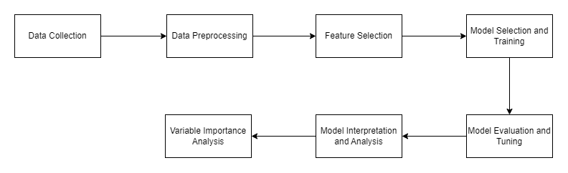
System Process Workflow
The system processing workflow for the Plant Growth Prediction System involves a comprehensive set of procedures designed to handle data collection, preprocessing, model development, evaluation, and insights derivation. These sequential steps provide a structured framework for the project, facilitating the progression of tasks essential to predicting optimal plant growth based on various environmental factors.

Slide 7
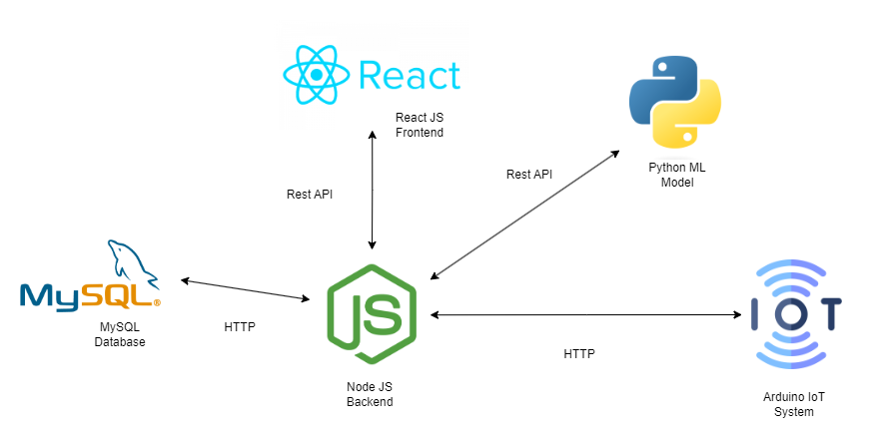
Architecture

Slide 8
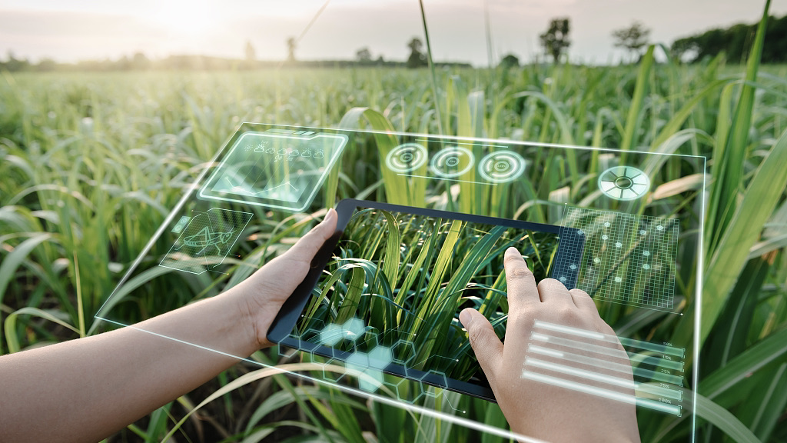
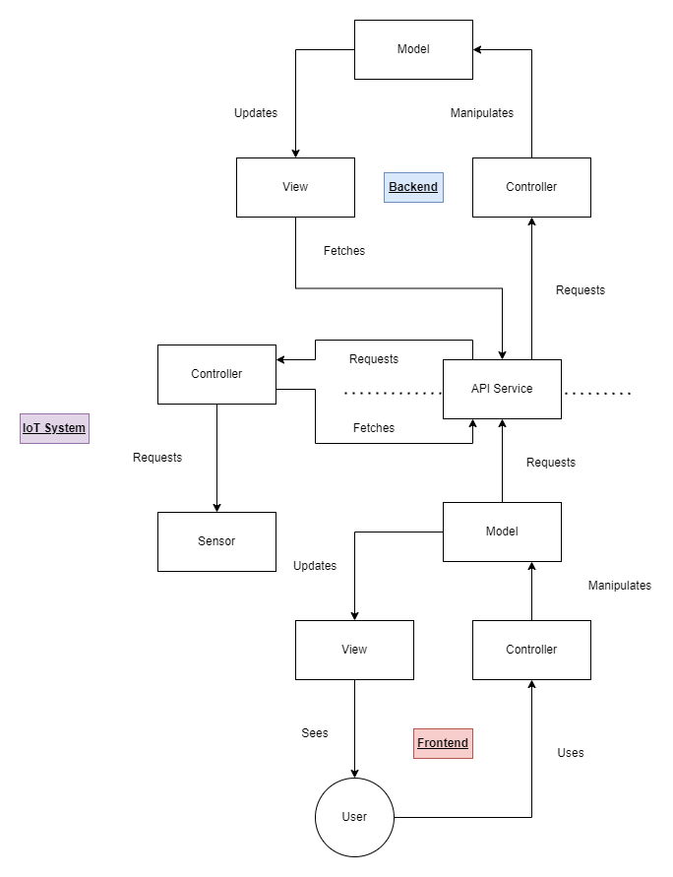



Frontend Web app communicate with backend using API services.
Frontend
Router Layer
UI Layer
Components Layer
API Layer
Backend
Router Layer
Service Layer
Data Access Layer
Backend and IoT device communicate with HTTP request.
IoT Device
Microcontroller
Sensors
OLED Display

Slide 9
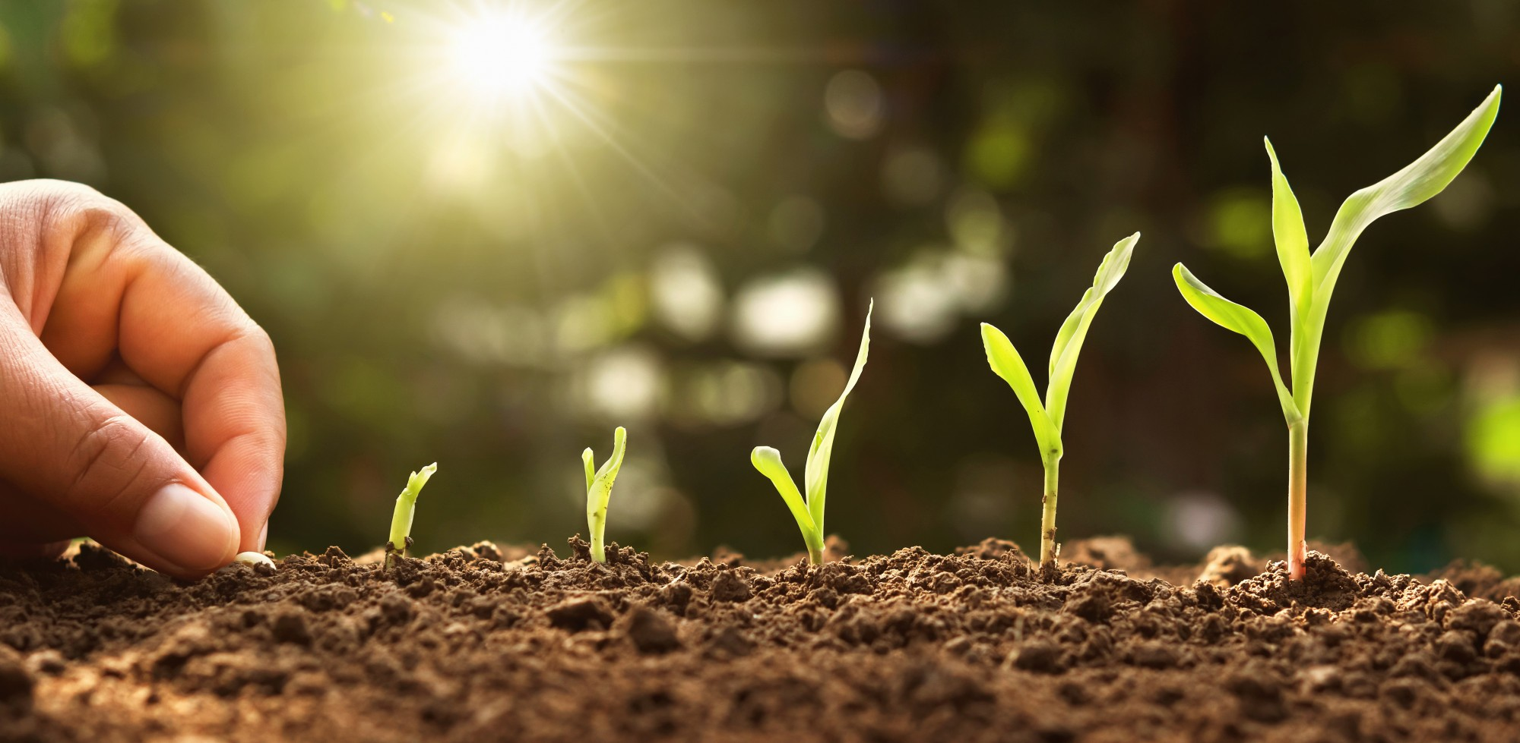
Thank You

